Slide 1
Operating Systems
Introduction of OS
Services provided by an OS
Structure of an OS (Kernel & Shell)
Types of Kernel
Dr. Dinesh C. Dobhal

Slide 2
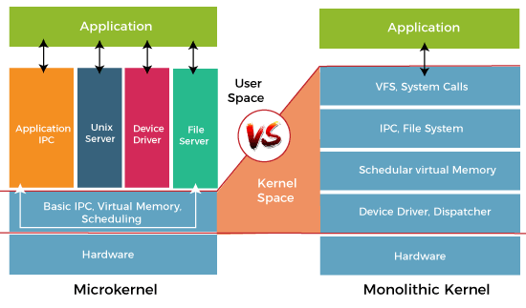
Types of Kernel

Slide 4
Operating System
Introduction of OS
Services provided by an OS
Structure of an OS (Kernel & Shell)
Types of Kernel
Types of OS
Dr. Dinesh C Dobhal

Slide 5
Types of OS
Batch Operating System
Multiprogramming Operating System
Multitasking Operating System
Real time Operating System
Multiprocessor Operating System

Slide 6


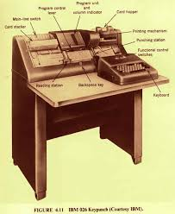
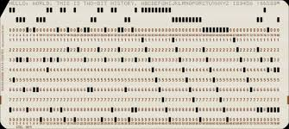
What is Punch Cards?
How punch cards were used?

Slide 7
Batch operating system
Jobs with similar needs are batched together and run as a group.
Firstly, user prepares his job using punch cards.
Then, he submits the job to the computer operator.
Operator collects the jobs from different users and sort the jobs into batches with similar needs.
Then, operator submits the batches to the computer and the job are taken by CPU one by one from the card reader.
When the job is finished, the operator separate and keep the printed output.

Slide 8
The problems with Batch Systems are as follows −
Lack of interaction between the user and the job.
CPU is often idle, because the speed of the mechanical I/O devices is slower than the CPU.
Low Throughput / Uniprogramming / Serial Processing [No Multiprogramming]
Wastage of memory [ Internal fragmentation ]
Card Reader
User Program
Processor
Punch Cards
OS
Memory

Slide 9
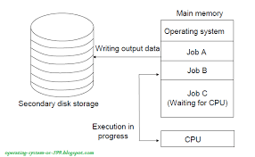
Multiprogramming OS
Start
Load
Complete
waiting
Execution
I/O
Higher Throughput
Better utilization of RAM

Slide 10
Multitasking / Time Sharing OS
Start
Load
Complete
Waiting
Execution
Timer Expire
I/O Request
I/O Complete
I/O
Higher Throughput
Better Utilization of RAM
Higher Interaction

Slide 11
Real Time Systems
Real time system means that the system is subjected to real time, i.e., response should be guaranteed within a specified time constraint or system should meet the specified deadline. For example: flight control system, Robotic surgery, etc.
Types of real time systems based on timing constraints:
Hard real time system – This type of system can never miss its deadline. Missing the deadline may have disastrous consequences.The usefulness of result produced by a hard real time system decreases abruptly and may become negative if tardiness increases. Tardiness means how late a real time system completes its task with respect to its deadline. Example: Flight controller system, Robotic surgery.
Soft real time system – This type of system can miss its deadline occasionally with some acceptably low probability. Missing the deadline have no disastrous consequences. The usefulness of result produced by a soft real time system decreases gradually with increase in tardiness. Example: reservation system

Slide 12
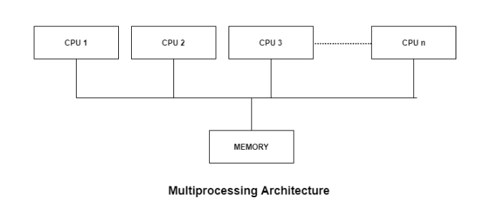
Multiprocessor operating system
Multiprocessor operating system allows the multiple processors, and these processors are connected with physical memory, computer buses, clocks, and peripheral devices. Main objective of using multiprocessor operating system is to consume high computing power and increase the execution speed of system.

Slide 13
Symmetric Multiprocessors
In these types of systems, each processor contains a similar copy of the operating system and they all communicate with each other. All the processors are in a peer to peer relationship i.e. no master - slave relationship exists between them.
UNIX and Windows NT support SMP.
Asymmetric Multiprocessors
In asymmetric systems, each processor is given a predefined task. There is a master processor that executes OS and gives instruction to all the other processors. Asymmetric multiprocessor system contains a master slave relationship. For example, IBM System/360

Slide 14
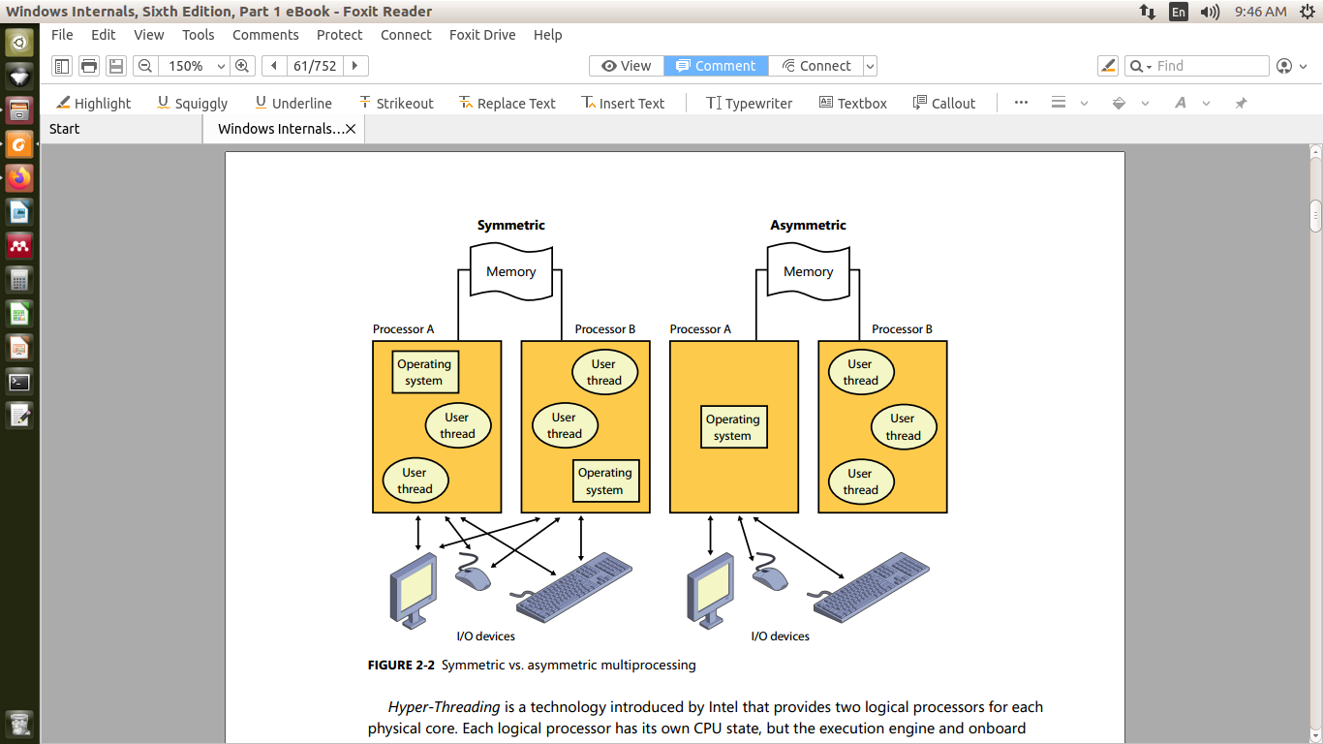

Slide 15
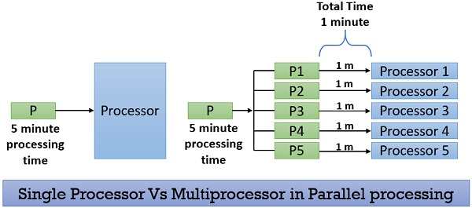
Parallel processing OS
It breaks the task or a process into sub-tasks and distribute these sub-tasks among all the available processors present in the system. Thereby, executing the task in the shortest time. All the processors in the system share the common secondary storage like the hard disk.

Slide 16
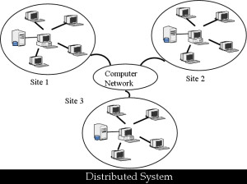
Distributed Operating System
Supports distributed system which is a model where computer application are running on a set of computers that are interconnected by network. These are loosely coupled system which means they have no hardware connection at CPU level. Distributed OS communicate with each other with LAN or WAN technology and also allows for various resource sharing.

Slide 17
Operating System
Types of OS
Booting of Operating System

Slide 18
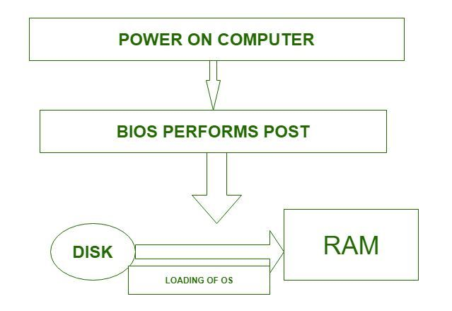
Booting is a startup sequence that starts the operating system of a computer when it is turned on.
Hard (Cold) Booting
POST is compulsory
Soft (Warm) Booting
POST is optional, No power cut
Shell---Kernel---MBR

Slide 19
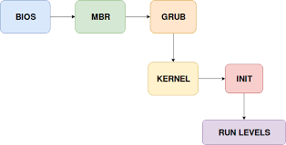
Linux Booting Process
Stage I II
GRand Unified Bootloader
Run levels
0 Shutdown
1 Single User Mode
2 Multiuser Mode (Limited)
3 Multiuser Mode (Full/CUI)
4 Not Used
5 Multiuser Mode (Full/GUI)
6 Restart
Shell / GUI

Slide 20
Linux Commands
Internal Commands
External Commands
User Programs
CPU
Disk
Shell
Kernel

Slide 22
Operating System
Unit 2
[Process Management]
Program, Process, & PCB
Context Switching,
Process scheduling,
CPU scheduling criteria,
Types of Schedulers & Scheduling algorithms,
Multiple-processor scheduling,
Threads

Slide 23
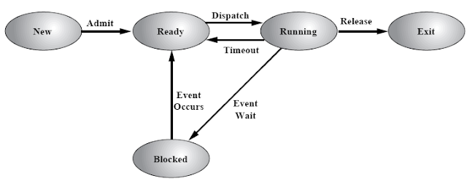
Program and the Process
Finite set of instructions (a.k.a Code) that is written in a particular programming language of a computer for a particular task. When a program is in running state, it is called as a process.
State Transition Diagram of a process

Slide 24
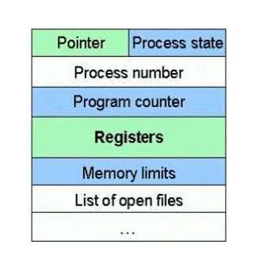
Process Control Block (PCB)

Slide 25
Operating System
Unit 2
[Process Management]
Program, Process, & PCB
Context Switching,
Process scheduling,
Types of Schedulers,
CPU scheduling criteria & Scheduling algorithms,
Multiple-processor scheduling,
Threads

Slide 26
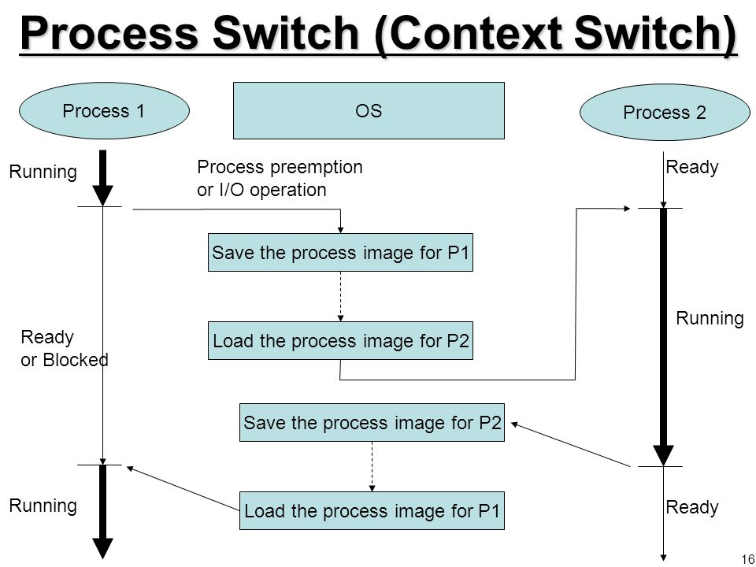
Context Switching:
is the process of storing the state of a process, so that it can be restored and resume execution at a later point.

Slide 27
Process scheduling:
Scheduling is the process of controlling the execution of the processes, in which operating system decides whether the currently running process should continue its execution, if not, which process should run next.
There are two main objectives of the process scheduling and they are:
To keep the CPU busy at all times and
To deliver "acceptable" response times for all programs, particularly for interactive ones.
Process Scheduling is done in the following four circumstances:
When a process switches from the running state to the waiting state
When a process switches from the running state to the ready state (For example, when an interrupt occurs)
When process switches from the waiting state to the ready state (For example, at completion of I/O)
When the process is terminated

Slide 28
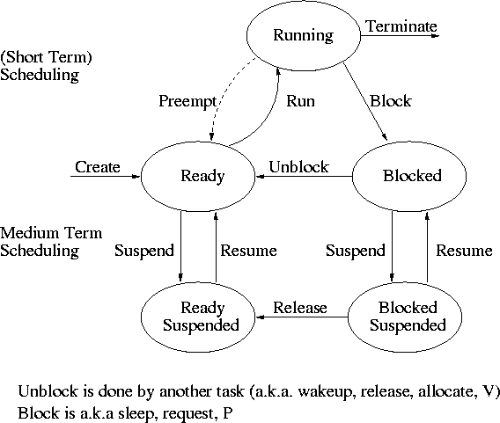
Types of Process Schedulers:
The process scheduler is the component of the operating system that is responsible for scheduling of the processes.
The long-term scheduler: It determines which programs are admitted to the system for processing. Thus, it controls the degree of multiprogramming.
The mid-term scheduler: It is part of swapping and determines when processes are to be suspended and resumed.
The short-term scheduler: It determines which of the ready processes can have CPU resources, and for how long.

Slide 29
Operating System
Unit 2
[Process Management]
Program, Process, & PCB
Context Switching,
Process scheduling,
Types of Schedulers,
CPU scheduling criteria & Scheduling algorithms,
Multiple-processor scheduling,
Threads

Slide 30
CPU scheduling criteria
Technical Terms:
Burst time: The time for which a process holds the CPU is known as burst time.
Arrival time: Arrival Time is the time at which a process arrives at the ready queue.
Turnaround time: The interval from the time of submission of a process to the time of completion is the turnaround time.
Waiting time: Waiting time is the amount of time a process has been waiting in the ready queue.
Response Time: Time between submission of requests and first response to the request.
Throughput: number of processes completed per unit time.
Dispatch latency – It is the time it takes for the dispatcher to stop one process and start another running.
I/O bound process: - The process which spends more of its time doing I/O operations than it spends doing computations are called I/O bound process.
CPU bound process: - The process that generates I/O request infrequently and uses more time for performing computations is called CPU bound process.
.

Slide 31
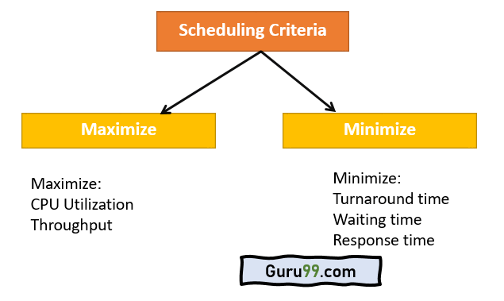

Slide 32
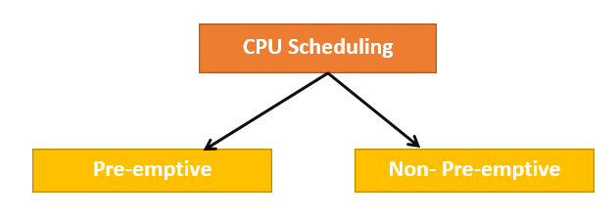
Scheduling Algorithms
CPU Scheduling is a process of determining which process will own CPU for execution while another process is on hold.
The main task of CPU scheduling is to make sure that whenever the CPU remains idle, the OS at least select one of the processes available in the ready queue for execution.
The selection process will be carried out by the CPU scheduler. It selects one of the processes in memory that are ready for execution.
Types of CPU Scheduling

Slide 33
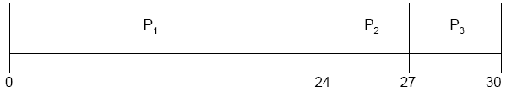
FCFS Scheduling Algorithms
Process | Arrival Time | CPU Burst | I/O Burst
P₁ | 0 | 24 | 0
P₂ | 0 | 3 | 0
P₃ | 0 | 3 | 0
The Gantt chart for the schedule is:

Slide 34
FCFS Scheduling Algorithms
Process | Arrival Time | CPU Burst
P₁ | 0 | 5
P₂ | 2 | 4
P₃ | 3 | 3
The Gantt chart for the schedule is:

Slide 35
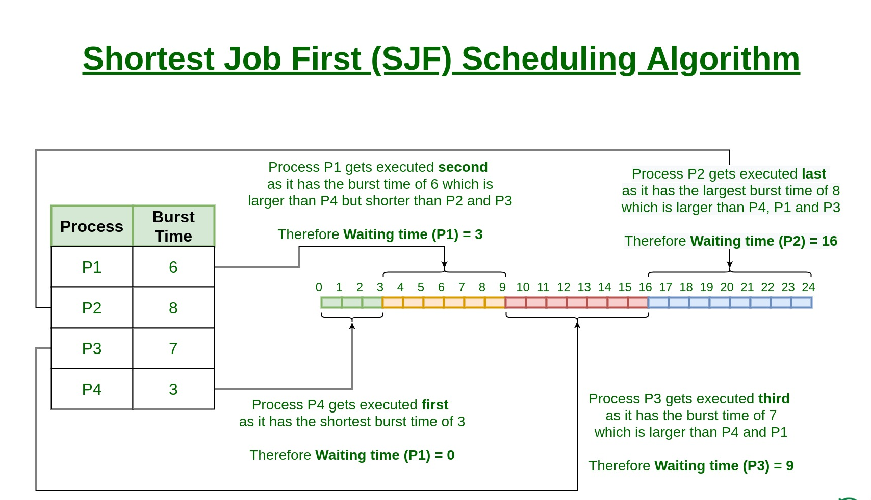

Slide 36
